Slide 1
White box Test design Techniques
Week#9-10

Slide 2
White Box Testing
Description:
Testing the internal structure and code of a software application.
Requires knowledge of the code.
Testers examine the code to find defects.
Also known as glass-box, open-box, or structural testing.

Slide 3
White Box Test Design Techniques
White Box Testing
Control Flow Testing
Statement Coverage
Branch Coverage
Decision Coverage
Path Coverage
Condition Coverage
Data Flow Testing
Mutation Testing

Slide 4
Control Flow Testing
A white-box testing technique.
Focuses on the order in which statements are executed.
Involves creating a Control Flow Graph (CFG).
Ensures all possible execution paths are covered.

Slide 5
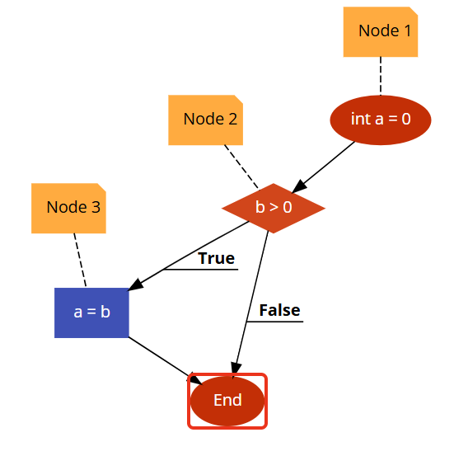
Control Flow Graph (CFG)
A diagram that represents the flow of control in a program.
Nodes represent statements or blocks of code.
Edges represent the transfer of control between nodes.
Example:
Nodes:
Node 1: int a = 0;
Node 2: if (b > 0)
Node 3: a = b;
Node 4: End of the program
Edges:
1 -> 2: The program starts by initializing a.
2 -> 3: If the condition (b > 0) is true, the program executes a = b;.
2 -> 4: If the condition (b > 0) is false, the program skips a = b; and goes to the end.
3 -> 4: After executing a = b;, the program goes to the end.

Slide 6
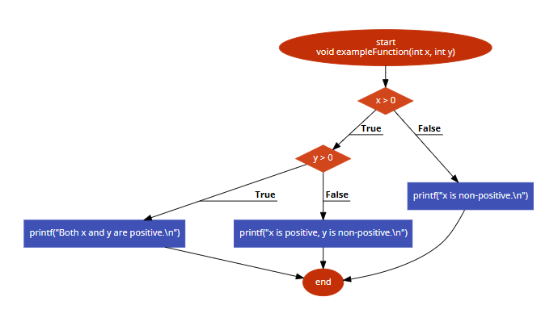
CFG continued
Nodes:
Node 1: void exampleFunction(int x, int y)
Node 2: if (x > 0)
Node 3: if (y > 0)
Node 4: printf("Both x and y are positive.\n");
Node 5: printf("x is positive, y is non-positive.\n");
Node 6: printf("x is non-positive.\n");
Node 7: Implicit return
Edges:
1 -> 2: Function entry to the first condition.
2 -> 3: x > 0 is true, going to the nested condition.
2 -> 6: x > 0 is false, going to the else block for x.
3 -> 4: y > 0 is true.
3 -> 5: y > 0 is false.
4 -> 7: After printing in the nested if's true block.
5 -> 7: After printing in the nested if's false block.
6 -> 7: After printing in the outer if's else block.
Example:
void exampleFunction(int x, int y) {
if (x > 0) {
if (y > 0) {
printf("Both x and y are positive.\n");
} else {
printf("x is positive, y is non-positive.\n");
}
} else {
printf("x is non-positive.\n");
}
}

Slide 7
Drawbacks of Control Flow Testing
The number of paths can reach huge figures. Modern applications are usually complex enough to render an attempt at exhaustive testing of all control flow paths quite impossible.
White box testing only works with implemented paths. If a path is missing, it will never be found. For example, here we want to calculate the grade based on the score. The code here misses the path for scores below 60.
def calculate_grade(score):
if score >= 90: grade = 'A'
elif score >= 80: grade = 'B'
elif score >= 70: grade = 'C'
elif score >= 60: grade = 'D'
# Missing implementation path for scores below 60 return grade
return grade

Slide 8
Drawbacks
There can also be errors within the code despite the correct flow. For example, here we want to calculate the inventory when an order is successfully dispatched. The flow is correct, but current_inventory is supposed to decrease (- 1) instead of (+ 1).
def calculate_inventory(order_dispatched, current_inventory):
if order_dispatched:
return current_inventory + 1

Slide 9
Code Coverage
A metric that measures how much of the code has been executed by tests.
Helps identify areas of code that are not being tested.
Expressed as a percentage.
Types:
Statement Coverage
Branch Coverage
Path Coverage

Slide 10
Statement Coverage
Ensures that every statement in the code is executed at least once.
Simplest form of code coverage.
Formula: (Number of executed statements / Total number of statements) * 100%
Example:
Example code and test case demonstrating statement coverage
int add(int a, int b) { // S1 int sum = a + b; // S2 return sum; // S3 }
Test Case: add(1, 2)
Executed Statements: S1, S2, S3
Coverage: 100%

Slide 11
Statement Coverage
Let's consider a simple example of a "grading system" function in a program:
function grade(score)
{ if (score >= 90) { return "A"; // Statement 1
}
else {
return "B"; // Statement 2
}}
If you only test the function with a score of 95, you only check if the program returns "A". You don't check if it correctly returns "B".
To achieve full statement coverage, you need two tests:
one with a score >= 90 (to execute "return A") and
one with a score < 90 (to execute "return B").

Slide 12
Branch Coverage
Ensures that every branch (decision) in the code is executed at least once.
Considers the outcomes of if-else statements, loops, etc.
A stronger measure than statement coverage.
Example:
Example code and test cases demonstrating branch coverage
if (x > 0) { // B1 (True) positive(); // S1 } else { // B2 (False) negativeOrZero(); // S2 }
Test Case 1: x = 5 (Executes B1, S1)
Test Case 2: x = -2 (Executes B2, S2)
Coverage: 100% (Both branches B1 and B2 are covered)

Slide 13
Path Coverage
Ensures that every possible path through the code is executed at least once.
The most comprehensive coverage but can be complex for large programs.
A path is a unique sequence of executed statements.
Example:
Example code with multiple paths
if (condition1) { // Path 1 statement1; // P1-1 } if (condition2) { // Path 2 statement2; // P2-1 }
Possible Paths:
Path A: condition1 = true, condition2 = true (P1-1, P2-1)
Path B: condition1 = true, condition2 = false (P1-1)
Path C: condition1 = false, condition2 = true (P2-1)
Path D: condition1 = false, condition2 = false (None)

Slide 14
Data Flow Testing
Data flow testing is like tracking how information (data) moves through a textbook. You want to make sure that when a concept is explained, it’s used correctly in examples and exercises later on.
In a program, this means checking how variables get their values and how those values are used in calculations or other operations.
For example, if a variable is supposed to store a student's ID, data flow testing checks that the ID is assigned correctly and used correctly whenever the student's information is needed.

Slide 15
Data Flow Testing
def is_adult(age):
if age >= 18: # Statement 1
return True # Statement 2
else: return False # Statement 3
Data flow testing checks how data (the value of age) flows through the code:
Check how the value of age affects the function's return value.
Test cases would include:
Verifying that the function returns True when age is 18 or greater.
Verifying that the function returns False when age is less than 18.

Slide 16
Cyclomatic Complexity
A metric that measures the complexity of a program.
Calculated using the Control Flow Graph (CFG).
Formula: V(G) = E - N + 2P (where E is the number of edges, N is the number of nodes)
Indicates the minimum number of test cases needed for branch coverage.
Example:
Example of calculating Cyclomatic complexity using a CFG

Slide 17
Cyclomatic Complexity:
Example:
void exampleFunction(int x, int y) {
if (x > 0) {
if (y > 0) {
printf("Both x and y are positive.\n");
} else {
printf("x is positive, y is non-positive.\n");
}
} else {
printf("x is non-positive.\n");
}}
V(G)=E-N+2(P) //P IS 1
V(G) = 8 - 7 + 2 = 3

Slide 18
Mutation Testing
Involves introducing small, artificial errors (mutations) into the code.
Tests whether the existing test cases can detect these mutations.
If test cases detect the mutation, the mutant is "killed."
Example:
Original code: if (x > y)
Mutated code: if (x >= y)
Test case: x = 5, y = 5
If the test case fails (detects the difference), the mutant is killed.

Slide 19
Advantages and disadvantages of White Box Testing
Advantages of White Box Testing
Reveals hidden errors.
Optimizes code.
More thorough testing.
Early detection of errors
Disadvantages of White Box Testing
Can be complex and time-consuming.
Requires programming knowledge.
May not catch all errors (e.g., missing requirements).
Difficult to use for large systems.

